Slide 1
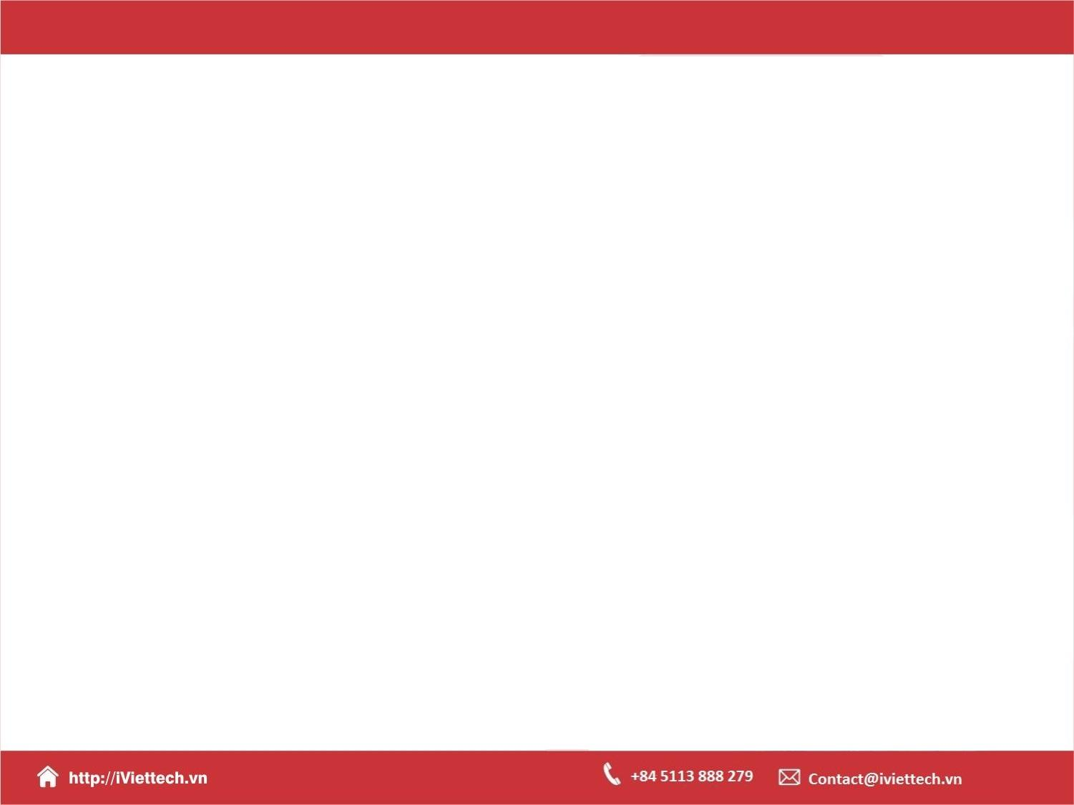
Chapter 6
How to test and debug
a JavaScript application
Notes:
Session: Ghi số thứ tự session trong môn học
Session Name: ghi tên của session sẽ dạy

Slide 2
Objectives
An introduction to testing and debugging
How to debug with Chrome’s developer tools
Other debugging methods
Notes:
Mô tả nội dung mà học viên phải đạt được khi kết thúc môn học này

Slide 3
An introduction to
testing and debugging
Notes:
Session: Ghi số thứ tự session trong môn học
Session Name: ghi tên của session sẽ dạy

Slide 4
An introduction to testing and debugging
Testing an application that you run it and make sure that it works correctly.
Debugging an application, that you fix the errors(bugs) that you discover during testing.

Slide 5
An introduction to testing and debugging (cont.)
The goal of testing:
To find all errors before the application is put into production.
The goal of debugging:
To fix all errors before the application is put into production.

Slide 6
An introduction to testing and debugging (cont.)
The three types of errors that can occur
Syntax errors
Runtime errors
Logic errors

Slide 7
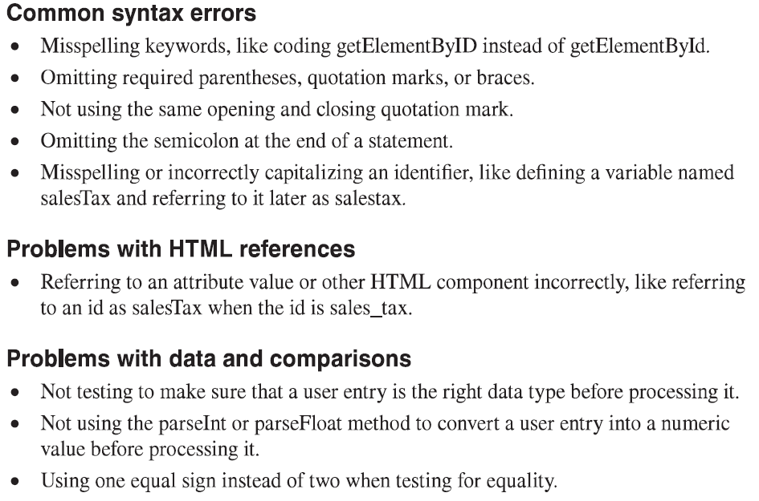
Common JavaScript errors

Slide 8
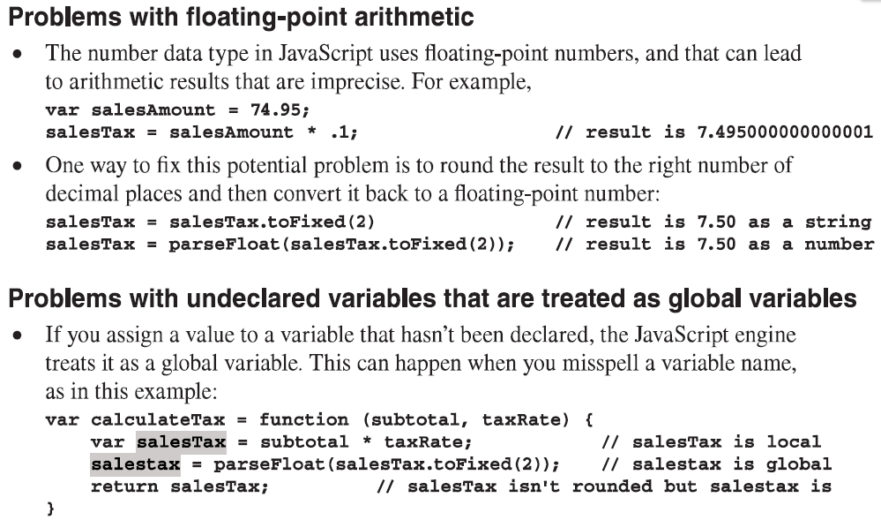
Common JavaScript errors(cont.)

Slide 9
How to plan the test run
There are at least two test phase:
1st phase: test application with valid data
2nd phase: test application with invalid data

Slide 10
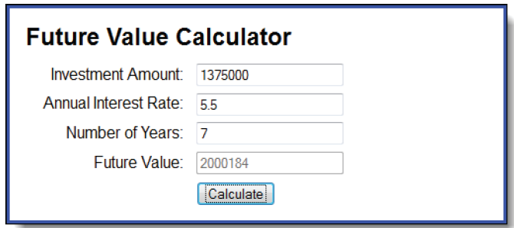
How to plan the test run (cont.)
Try to test with Future Value application

Slide 11
How to plan the test run (cont.)
Two common testing problems
Not testing a wide enough range of entries
Not knowing what the results of each set of entries should be and assuming that the results are correct because they look correct.

Slide 12
How to use top-down coding and testing simplify debugging
Top-down coding and testing that you start by coding and testing a small portion of code.
You can build first with small code then add more code to test for next phase.

Slide 13
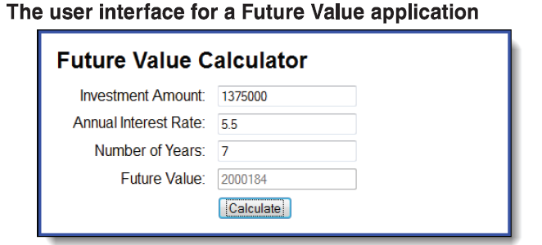
How to use top-down coding and testing simplify debugging (cont.)
Look at example

Slide 14
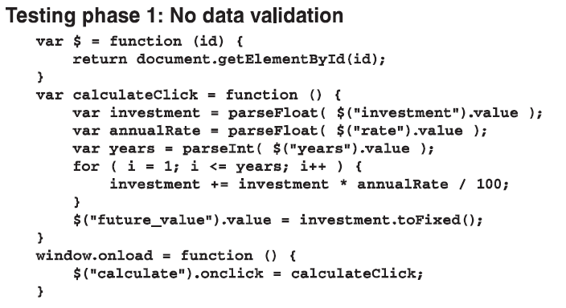
How to use top-down coding and testing simplify debugging (cont.)

Slide 15
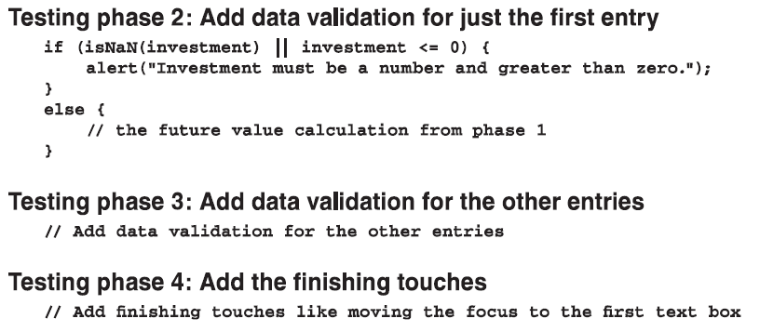
How to use top-down coding and testing simplify debugging (cont.)

Slide 16
How to debug with Chrome’s developer tools
Notes:
Session: Ghi số thứ tự session trong môn học
Session Name: ghi tên của session sẽ dạy

Slide 17
How to debug with Chrome’s developer tools
Chome’s developer tools provide some excellent debugging features, like identifying the JavaScript statement that caused an error.
Press F12 key to start the chrome’s development tools.

Slide 18
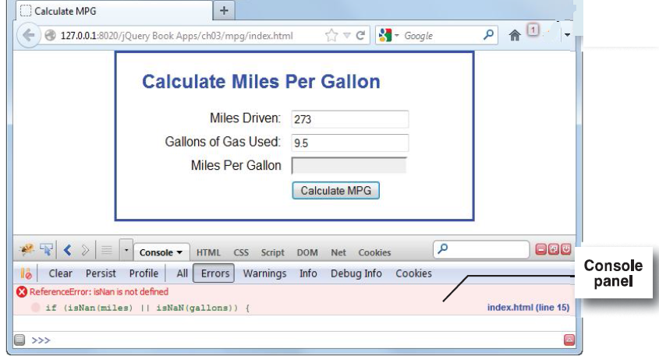
How to debug with Chrome’s developer tools (cont.)

Slide 19
How to use breakpoints and step through your code
You can set a breakpoint to stop the execution of your application.
The execution of application will stop before statement that is set breakpoint.
You can see value of variables in watch windows. They can help you define caused of error.

Slide 20
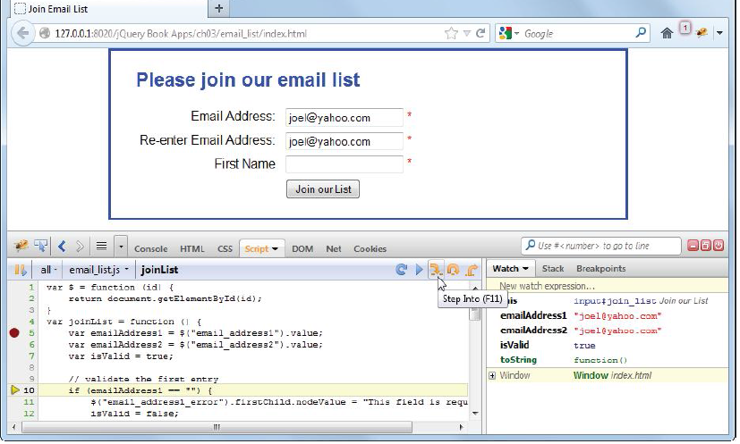
How to use breakpoints and step through your code (cont.)

Slide 21
How to use breakpoints and step through your code (cont.)
You can step through the JavaScript code by press the keys below.
Button | Key | Description
Step Into | F11 | Step through the code one line at a time.
Step Over | F10 | Run any called functions without stepping through them.
Step Out | SHIFT + F11 | Execute the rest of a function without stepping through it.
Resume | F8 | Resume normal execution.

Slide 22
Other debugging methods
Notes:
Session: Ghi số thứ tự session trong môn học
Session Name: ghi tên của session sẽ dạy

Slide 23
How to trace the execution of your JavaScript code
You can insert console().log method to display values of key variable at a key point to console panel.
Or you can use aler() method to display values of key variable at a key point to popups.
Base on the value of key variable you can determine the caused of error.

Slide 24
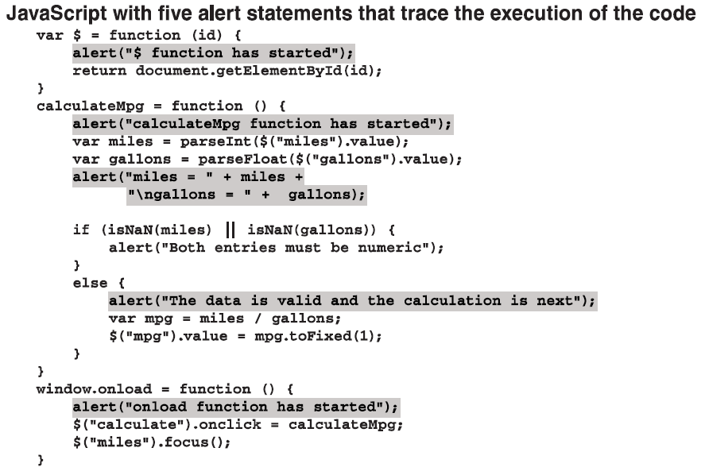
How to trace the execution of your JavaScript code (example)

Slide 25
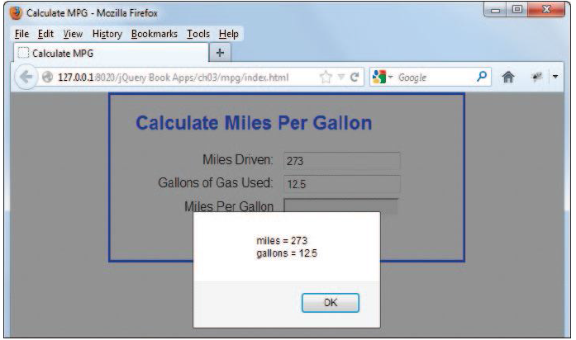
How to trace the execution of your JavaScript code (example)

Slide 26
How to view the source code
You can view the source code of HTML and JavaScript to identify an error.
Right click on page and select View Source or View Page Source to display the source code of page.

Slide 27
How to validate the HTML
W3C provide a tool permit you validate your html file at http://validator.w3.org/
This tool will check and report the error in HTML file to you. Then you can fix it.

Slide 28
Summary
Testing an application that you run it and make sure that it works correctly.
Debugging an application, that you fix the errors(bugs) that you discover during testing.
The three types of errors that can occur: Syntax errors, Runtime errors,Logic errors.
There are at least two test phase:
1st phase: test application with valid data
2nd phase: test application with invalid data
Chome’s developer tools provide some excellent debugging features, like identifying the JavaScript statement that caused an error.
Notes:
Tóm tắt lại nội dung đã học

Slide 29
Summary(cont.)
You can set a breakpoint to stop the execution of your application.
The execution of application will stop before statement that is set breakpoint.
You can see value of variables in watch windows. They can help you define caused of error.
You can step through the JavaScript code to identify the caused of error.
You can use trace of code, view source or HTML validator tool of W3C to debugging an application.

